Slide 1
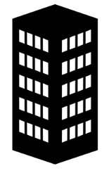
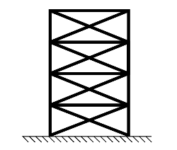
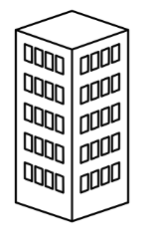
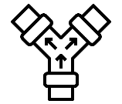



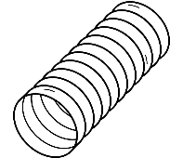

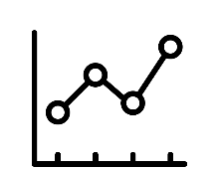


Enables Creation of Higher order abstractions of knowhow
Composition
Transdisciplinary
Buildings and Habitats
Systems and Relational Networks
Elements
Primitive Objects
Higher order objects
Quantities
Primitive Properties

Slide 2


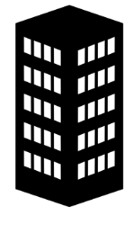
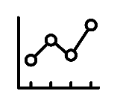



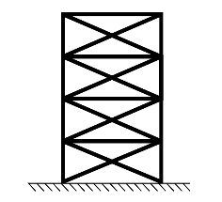
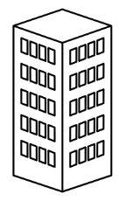



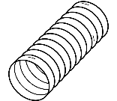


Delivered Through One Open Source CodeBase = BHoM
Integrated Object Model Composition -> higher order concepts
Quantities
Primitive Properties
Primitive Objects
Systems and Relational Networks
Transdisciplinary
Buildings and Habitats
Qualia and Health and Wellbeing
Elements
MATERIAL BEHAVIOR
OBJECT ANALYSIS
SYSTEM ANALYSIS
HUMAN INTERACTION
INDIVIDUAL EXPERIENCE
Notes:
No master layout—copy/paste directly from this slide.

Slide 3
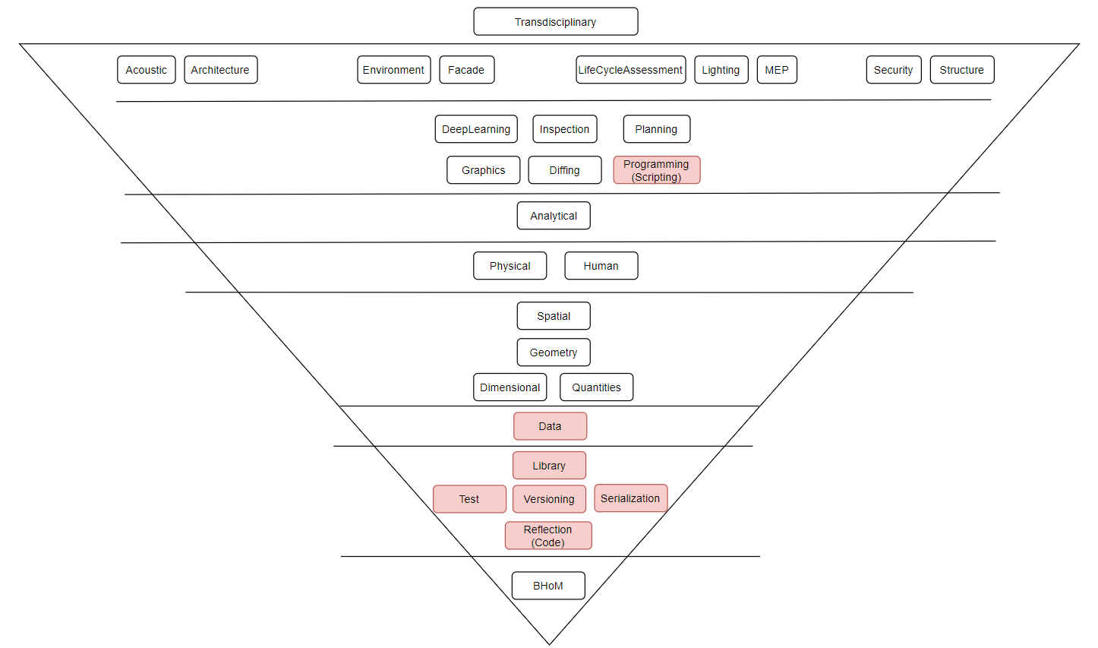
Common Object Model

Slide 4
Common Object Model
Analytical
Physical
Dimensional
Numerical

Slide 5
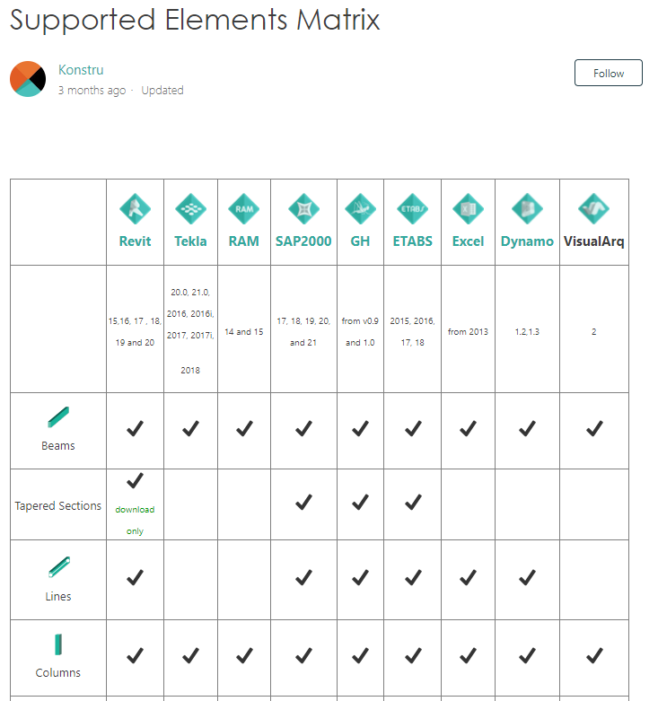
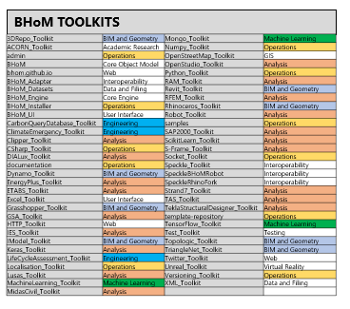
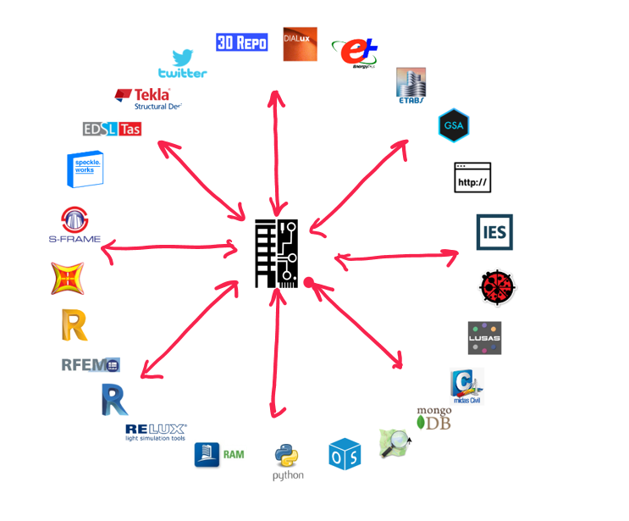
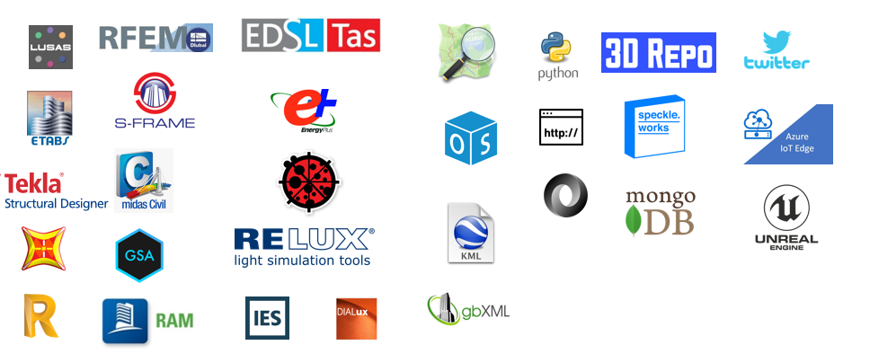




Types of Adapter Diagram
Showing connections to BHoM Types (simple as type is referenced by adapter)
Hub diagram
Grouped by disciple/classification
Matrix (could show push vs pull) or CRUD methods?
Simple list of available adapters

Slide 6
Why all the interfaces on Elements?
Three reasons:
A. Standardising engine methods for performing universal calculations
B. Standardising means for consuming, visualisation and reporting elements
C. Relate multiple representations together, convert and derive relative representations. casting relationships across transdisciplinary elements

Slide 7
A. Standardising engine methods for performing universal calculations
Spatial Engine – Model Laundry
Graph and topology queries - Graphflow
Matter Engine
Life Cycle Assessment
Data processing and analytics

Slide 8






B. Standardising means for consuming, visualisation and reporting elements
IResults
Analytical
Game Engines
+
3D Viewers
+
Dashboards
IGeometry
Geometry
Graphics
Dimensional
IElements
Quantities
Base Object

Slide 9


C. Relate multiple representations together, convert and derive relative representations. casting relationships across transdisciplinary elements
Transdisciplinary
Scripts
IModel
ISystem
IElements

Slide 10
Use Rebar 4.0 as example
Ledger GUIDS
ETABS
Structure
Slab
Results
Structure
Structure
Structure
Structure
Fabrication
Site Survey
Panel
Rebar Intent
Rebar
Full 3D Rebar
3D Rebar
3D Rebar
Physical
Physical
IFC
Revit
Slab
Floor
3D Rebar
Revit
IFC
Slab
Rebar
Rebar
How do these representations all relate? Cross reference each other?

